Slide 1
OCLC Knowledge Base: Improving patron discovery
Jennifer Nelson
Notes:
What is the knowledge base
Why you might want to use it
How to get started if you are interested
Viterbo’s experiences

Slide 2
What is the Knowledge Base?
The KB combines e-resource information (data) and linking to improve access and workflows
https://oclc.org/knowledge-base.en.html

Slide 3
Why use the knowledge base?
Its how e-resources are discovered through WorldCat Local/WorldShare Discovery
WorldShare Management Services
Foundational (even if you don’t use a KB service now, you probably will at some point)

Slide 4
How to get started
Notes:
WorldCat Config
WorldShare Metatdata or Licenses

Slide 5
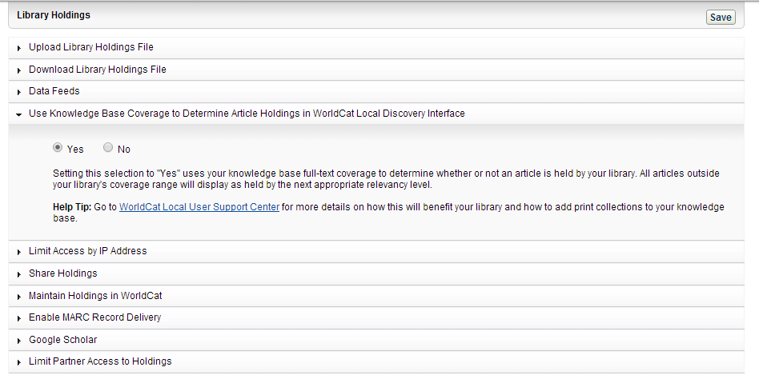
How to Get started

Slide 6
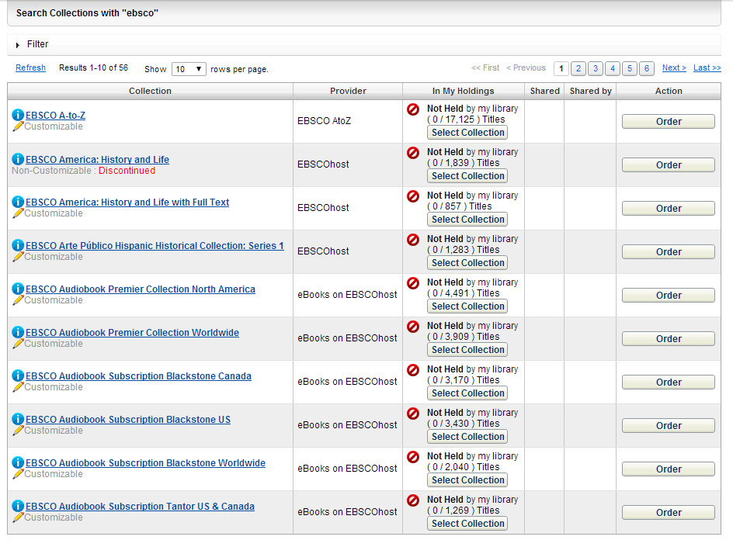
How to Get started

Slide 7
Past
Notes:
Historical ILS
Traditional catalog, no discovery capabilities
Information was silo’ed
Process to get e content into ILS was prohibitive. We couldn’t do it. Now we can go into the KB, find the collection, turn it on and it is available in WCL
Can also upload non-standard collections (like print holdings)

Slide 8
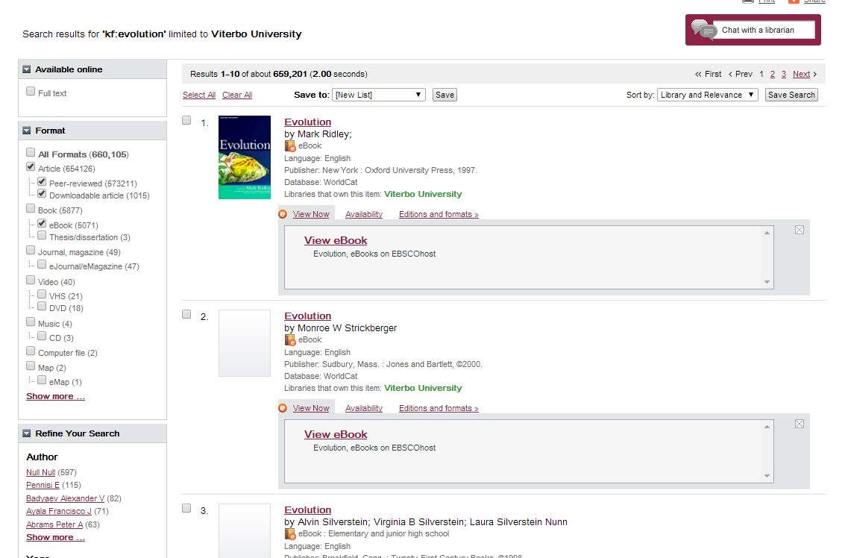
Present
Notes:
WorldCat Local – how Knowledge Base resources are found
Workflow - Now we can go into the KB, find the collection, turn it on and it is available in WCL
Can also upload non-standard collections (like print holdings)

Slide 9
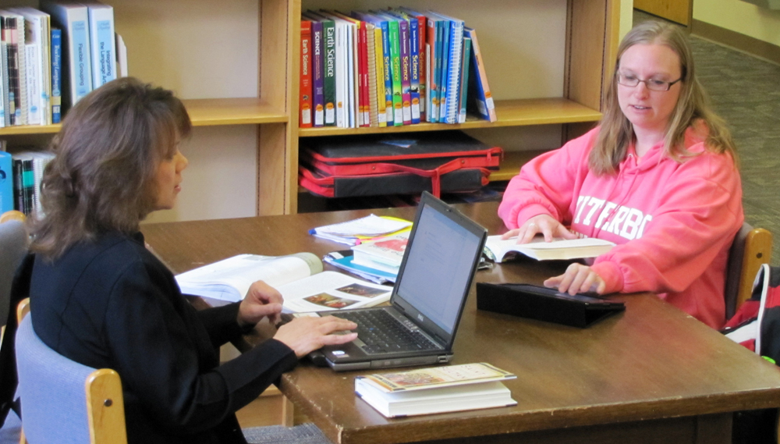
Impact - Students
Notes:
Finding new types of materials
Print journal articles
Identifying resource types
Finding more resources!
Shallow searching

Slide 10
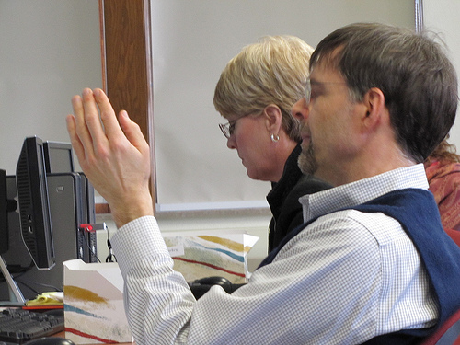
Impact – Faculty
Notes:
Restrictions on students resources
“Its too easy”
Moving from finding culture to evaluation culture

Slide 11
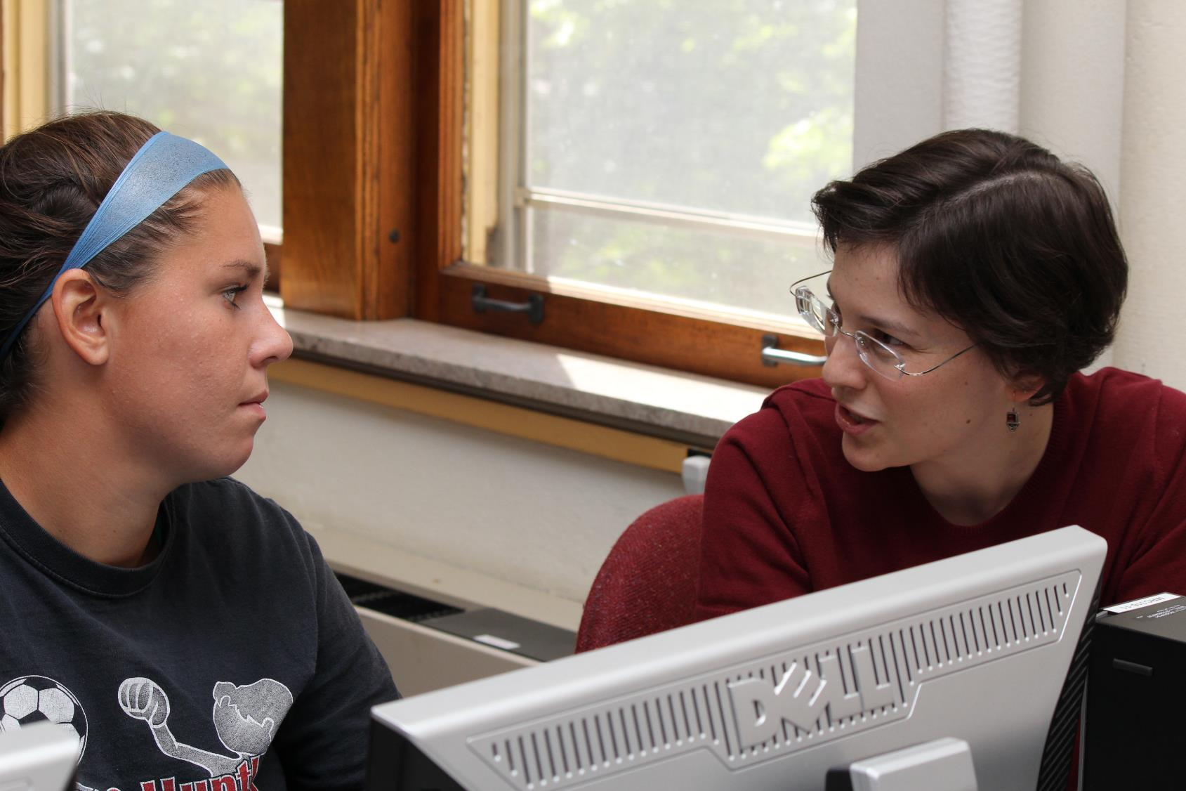
Impact – Library staff/Workflows
Notes:
How do we use this?
How do we teach this?
Constantly changing ILS means we have to constantly keep track of new developments
Reference services have become more dynamic
Workflow improvements allow us to do more – ebook collections for example have doubled the size of our collection

Slide 12
Questions?
Jennifer Nelson
jnnelson@viterbo.edu

