Slide 1
OCLC Knowledge Base:
The ILL perspective

Slide 2
B.K.B. (Before the Knowledge Base)
Unsure of what we can loan from our e-journals or the best way to borrow from e-content
Many of us did not (and don’t) have our electronic content in OCLC and therefore, not discoverable
Majority of our content, especially our unique content, is e-journal subscriptions

Slide 3
OCLC Translation
http://www.oclc.org/en-US/worldshare-ill/features/article-sharing.html
Simplifies the lending of electronic content
Allows you to set licensing restrictions depending on publisher terms
Allows you to automate ILL borrowing for articles
Recognizes borrowing requests for items that you own
All of this fits neatly into ILLiad and most into Worldshare ILL

Slide 4
Nuts and Bolts of the KB
Basically an Electronic Resource Manager (ERM) for ILL
Homework required:
Electronic subscriptions- database packages, e-journal packages, and/or individual journals (easy peasy!)
Licensing agreements for your subscriptions (easy peasy!)

Slide 5
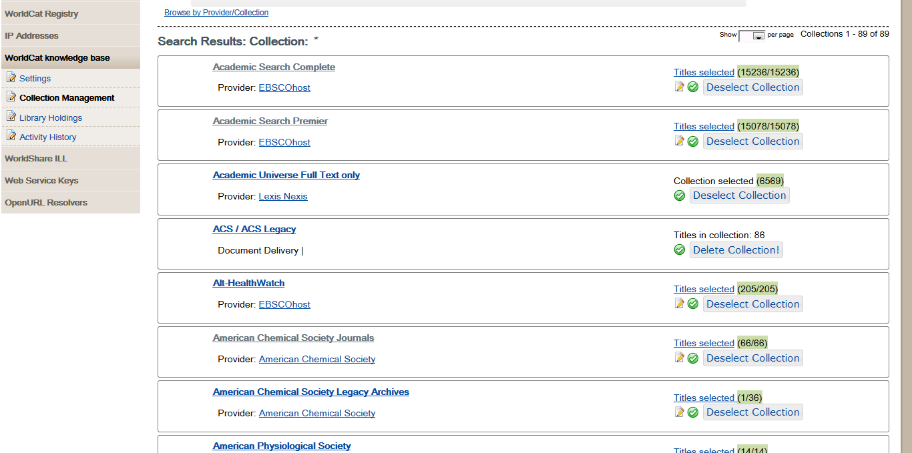

Slide 6
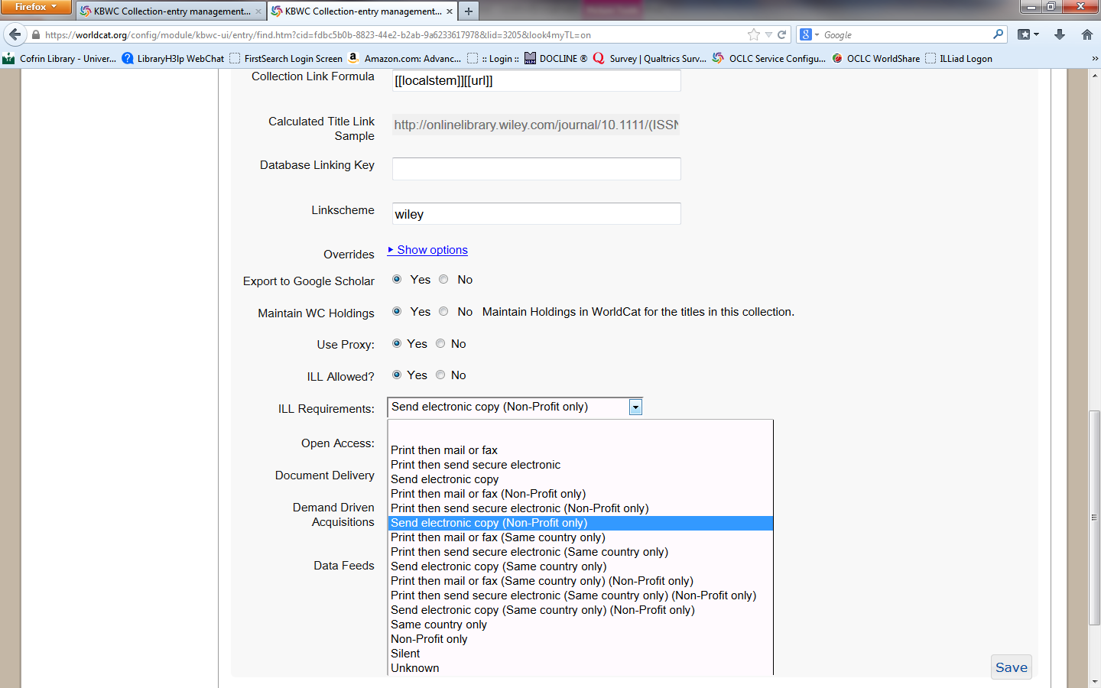

Slide 7
Lending e-materials (ILLiad)
Routing rule: checks all article lending request against KB holdings
t.username = 'GZW' and t.TransactionNumber in (select distinct TransactionNumber from OCLCCollectionData)
Custom Queue – Awaiting Ejournal Processing

Slide 8
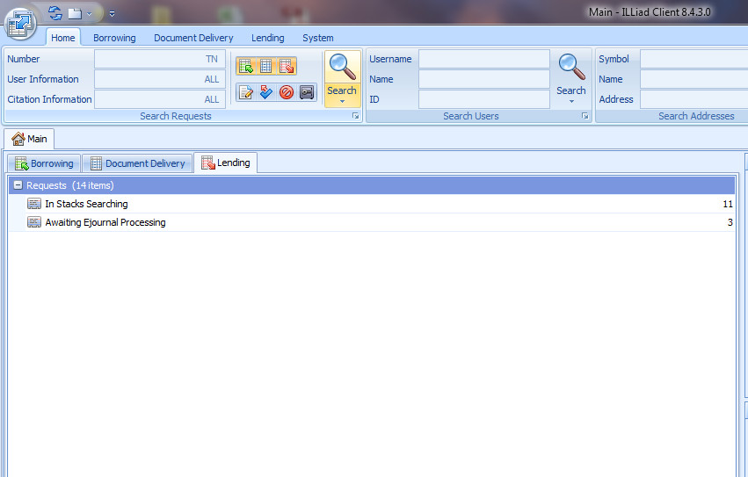

Slide 9
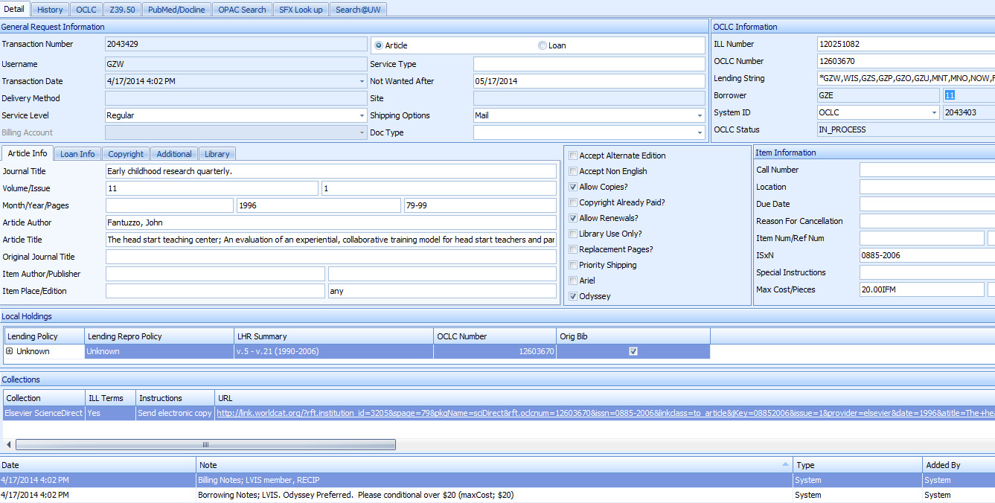

Slide 10
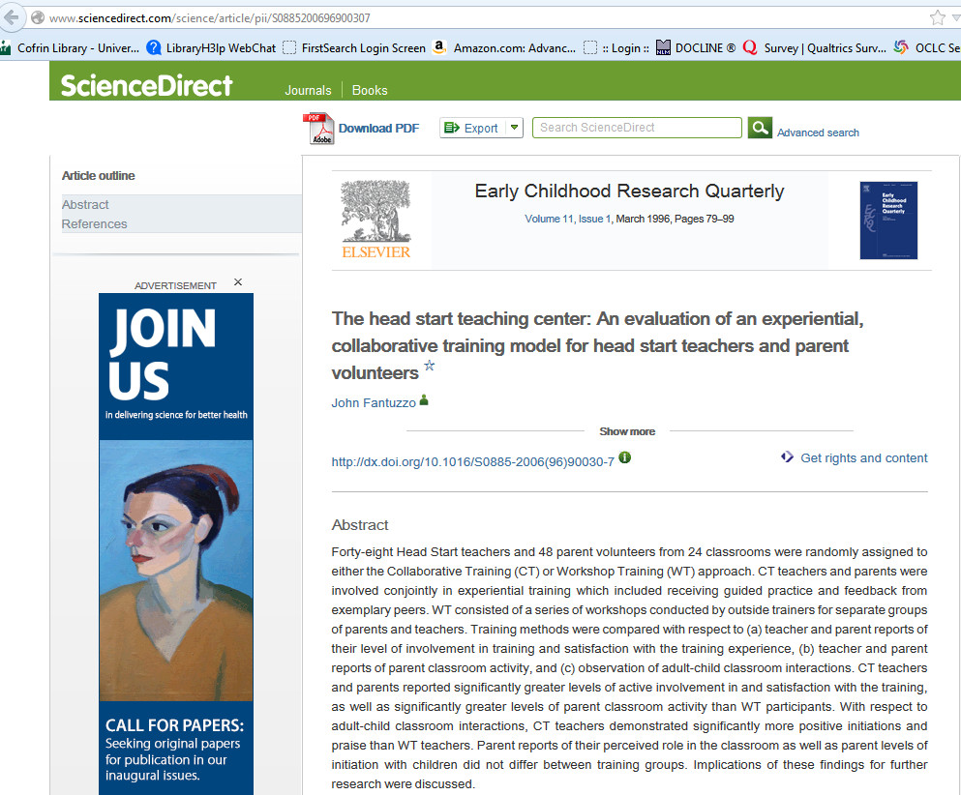

Slide 11
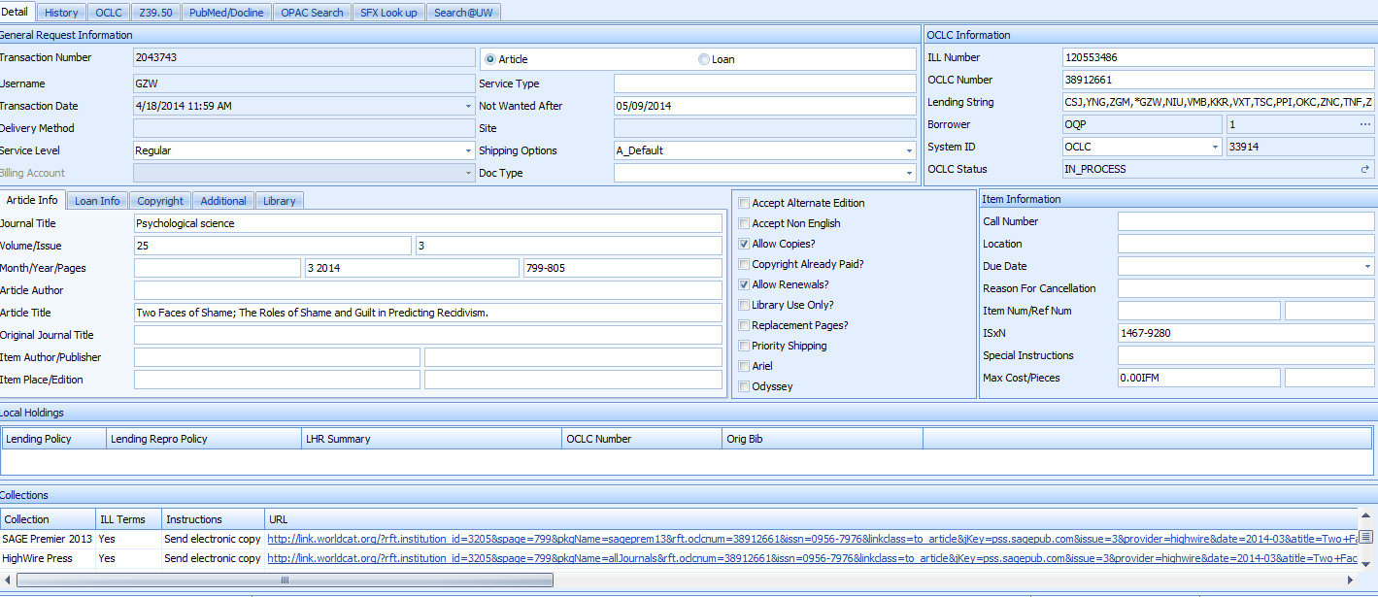

Slide 12
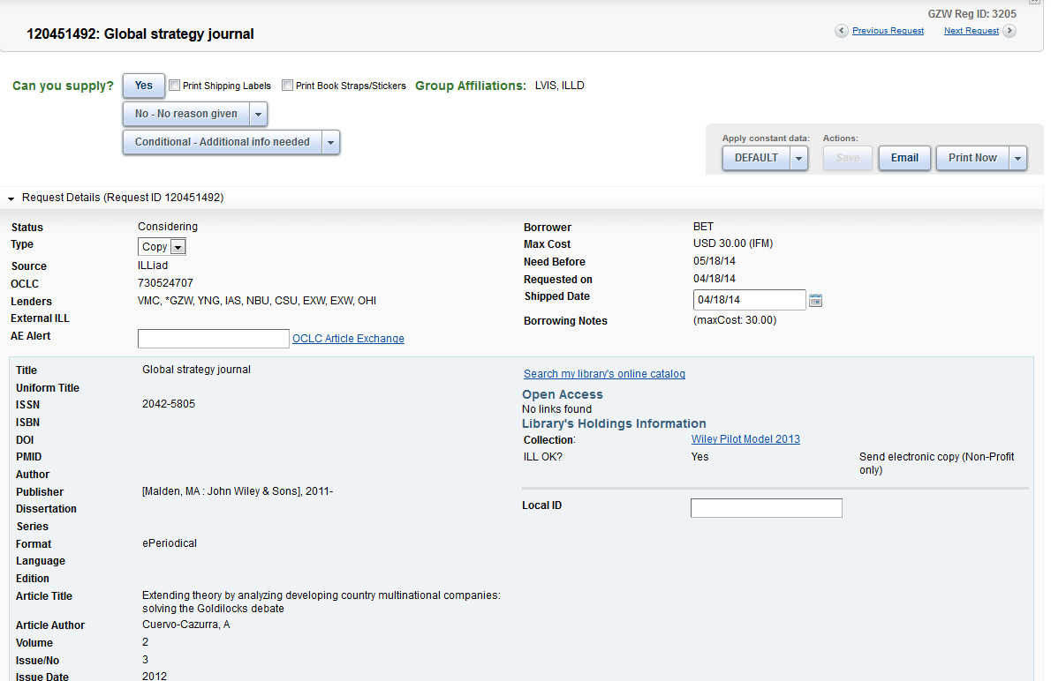
Worldshare ILL

Slide 13
Automating Borrowing requests:
Done through Direct Request
Must set up an DR article profile
Set up a custom holdings group & path
Included only KB libraries and LVIS libraries

Slide 14
KB Group

Slide 15
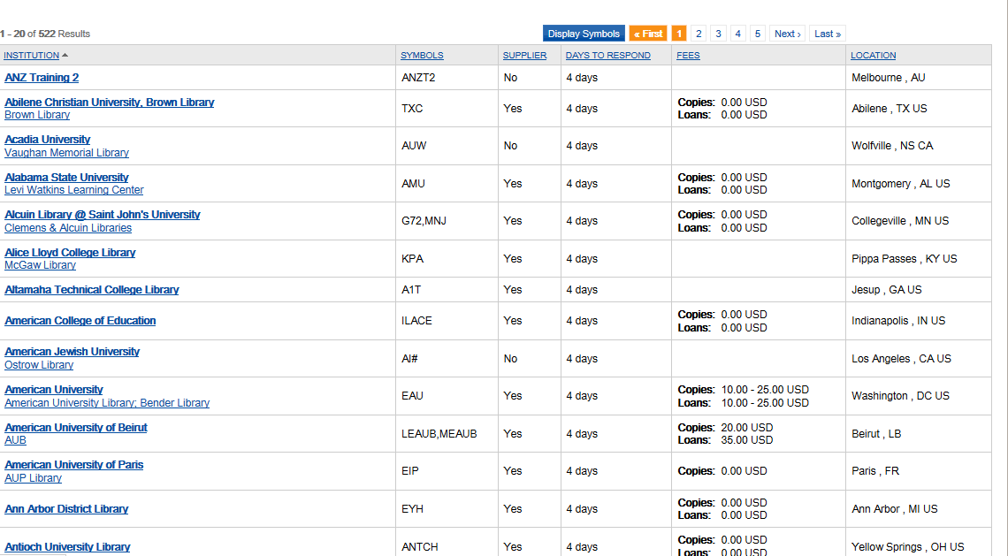

Slide 16
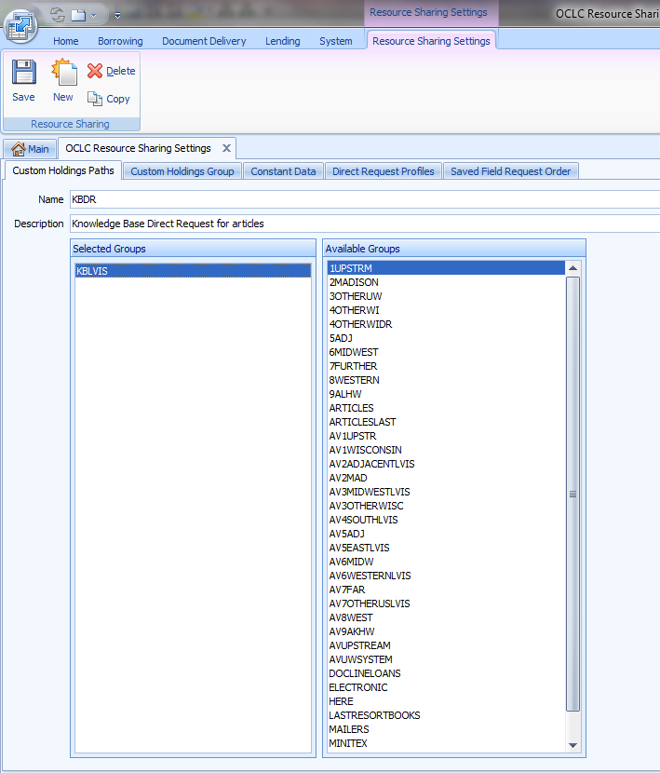

Slide 18
ILLiad KB routing rules
2 ILLiad routing rules
u.NVTGC = 'GZW' and (t.ISSN > '' or t.ESPNumber > '') and t.RequestType = 'Article' and (t.LendingString = '' or t.LendingString is NULL) and u.cleared = 'Yes‘
u.NVTGC = 'GZW' and t.TransactionNumber in (select distinct TransactionNumber from OCLCCollectionData)
1st- sends article requests out through Direct Request
2nd- checks every article request against KB holdings and returns any request that matches

Slide 19
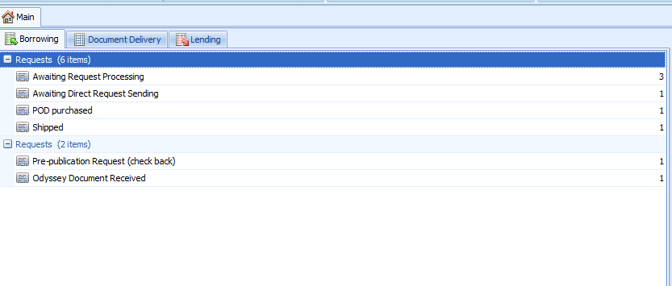
Direct Request for articles
2 types of DR article requests:
Requests released from Copy Right by User –published in last five years (semi-mediated)
Requests released from Copy Right by the system – not published in last five years (unmediated!)

Slide 21
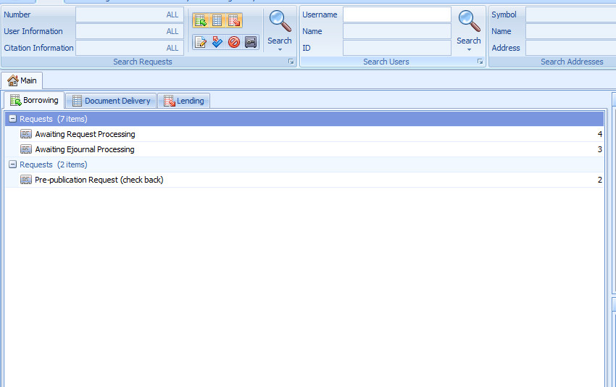

Slide 23
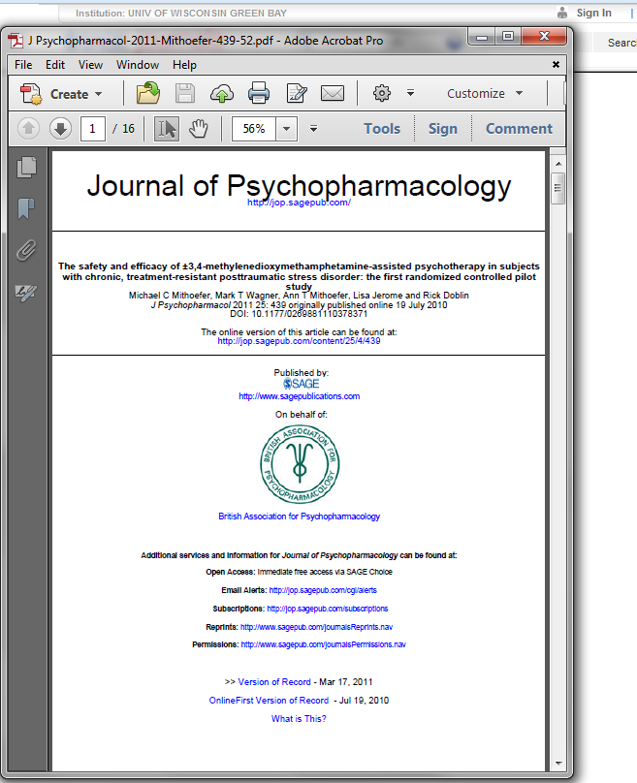

Slide 24
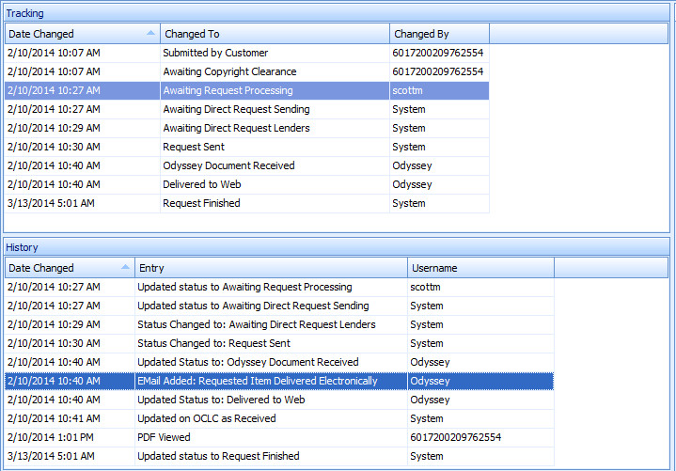
Why you should do this!
Articles cleared from CC by user:

Slide 25
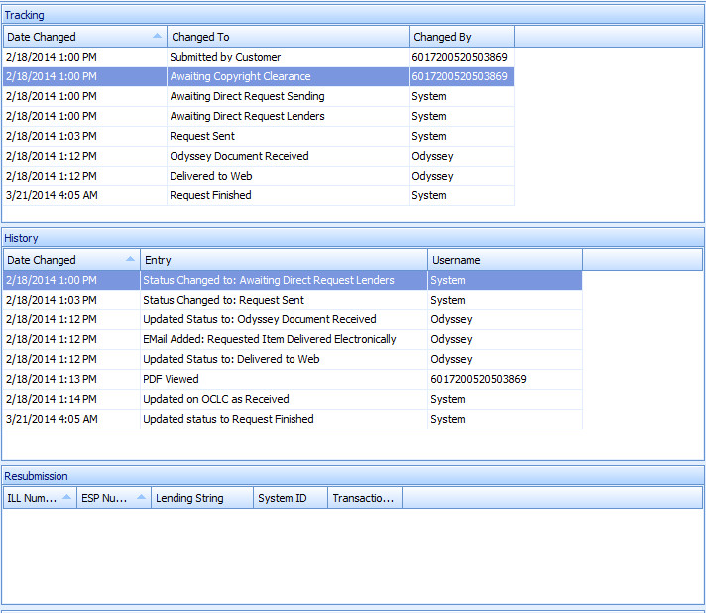
Why you should do this!
Completely unmediated

Slide 26
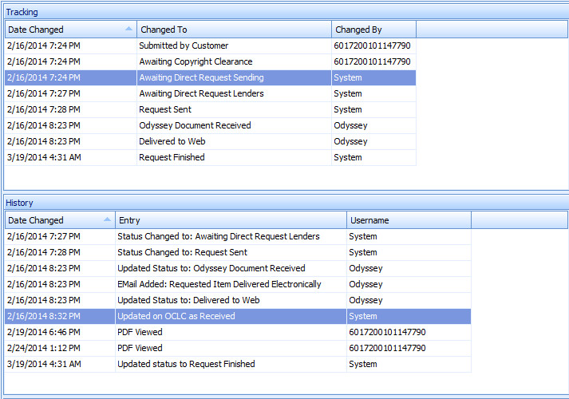
Works on weekends!

Slide 27
KB and Direct Request at UW-GB

Slide 28
KB assessment

Slide 29
KB assessment II

Slide 30
Questions????

