Slide 1
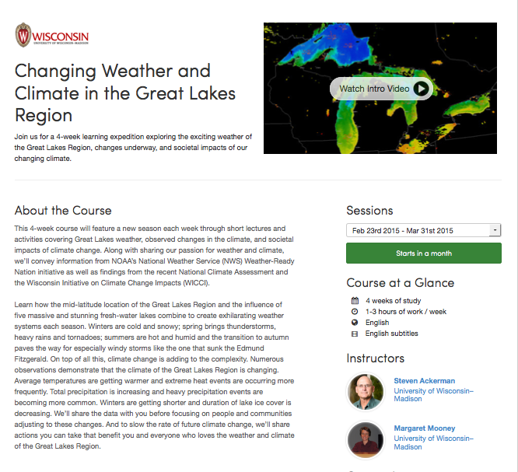

Slide 2
Changing Climate and Weather in the Great Lakes Region
Draft slides = incorporate into Steve/Margaret’s content for libraries presentation Tuesday, Jan 12

Slide 3
Goals for this webinar:
To record an introduction to the course and help familiarize libraries with Coursera
Demonstrate
how to login to Coursera
how to navigate the course
how to download videos
Overview - What’s the “big picture” of the course?
Quick tour thru the first week of content
Discussions and Libraries
Questions?
Notes:
I added the discussions and libraries item – I’m sure they will want to talk about this!
What else???

Slide 4
Introductions
Steve Ackerman
Atmospheric & Oceanic Sciences Cooperative Institute for Meteorological Satellite Studies
Margaret Mooney
Cooperative Institute for Meteorological Satellite Studies
Kari Jordahl
UW-Madison Div. of Information Technology
Stef Morrill
WiLS
Libraries on the call

Slide 5
Coursera Video Tour (4.27 mins)
https://www.youtube.com/watch?v=3WK1l-7Wnzs#t=91
Notes:
The first 3 minutes is great – can stop after quizzes or finish -
We’re not doing peer review – after peer review they briefly discuss statement of accomplishment
https://www.youtube.com/watch?v=3WK1l-7Wnzs#t=91
Embed code:
<iframe width="560" height="315" src="//www.youtube.com/embed/3WK1l-7Wnzs" frameborder="0" allowfullscreen></iframe>

Slide 6
How to Login to Coursera
Go to www.Coursera.org
OR begin at the UW-Madison MOOCs website
http://moocs.wisc.edu/mooc/great-lakes-weather-and-climate/
Create an account
Quick reference guide
http://moocs.wisc.edu/wp-content/uploads/2014/12/How-to-Create-a-Coursera-Account.pdf
Notes:
Kari – walk through
Show help docs on UW Madison MOOC website
Show Coursera Learner Support site
https://courserahelp.zendesk.com/hc/en-us#The_Basics

Slide 7
The Big Picture

Slide 8
Navigation – Let’s look at Winter
Caveats
This is not final content – rather it gives you an idea of how it will look and feel when we launch
We are still working to edit videos, add visual assets, obtain closed captions/transcriptions
We are still working on writing up activities and formalizing requirements, etc.
Discussion prompts are also not finalized

Slide 9
Discussions and Libraries

Slide 10
Handy Resources
UW-Madison MOOCs website
http://moocs.wisc.edu/
General info about the courses
Also links to a little bit of help with Coursera
How do you create a Coursera account?
How do I sign into Coursera? Forgotten password?
Coursera
For help with the course/interface
Learner Help Center
https://courserahelp.zendesk.com/hc/en-us

Slide 11
Questions?

