Slide 1
Welcome to WiLS Regional Community Meeting!
UW- Milwaukee Libraries

Slide 2
Maximizing the Value of Electronic Resources

Slide 4
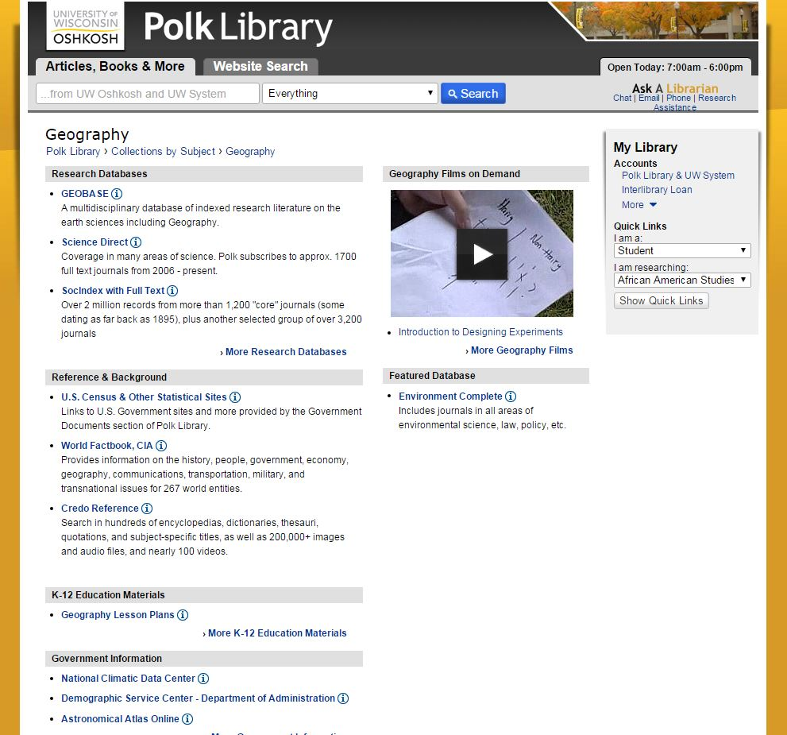
Notes:
Polk Library’s Subject Guides and Course Pages
http://www.uwosh.edu/library

Slide 5
Notes:
Polk Library’s Subject Guides and Course Pages
http://www.uwosh.edu/library

Slide 6
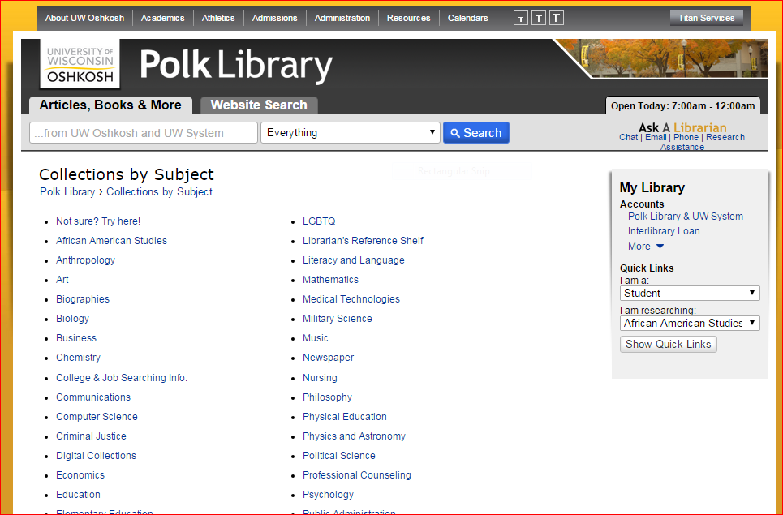
Put your resources in front of your users.
Group them together in a way that aids in their discoverability.
Too often we find resources are buried or hard to find.

Slide 7
ROTATE!
Make sure that sparsely used resources get some spotlight time too, even if it’s not the “best in class.”

Slide 8
Promote…Promote…Promote

Slide 9
Work with a subject specialist.

Slide 10
Reach out to your vendor rep

Slide 13
Know More http://scls.typepad.com/ce/database_tips/

Slide 14
Know more not everything

Slide 16
Reinforce training with written documentation

Slide 17
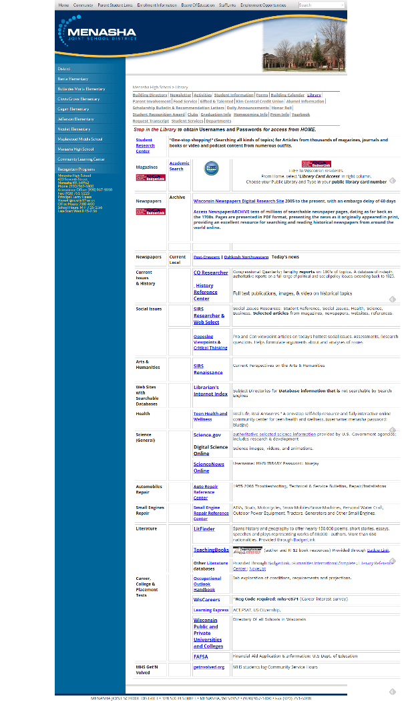
Menasha Joint School District

Slide 18
Meet users where they are

Slide 19
Access should be easy

Slide 22
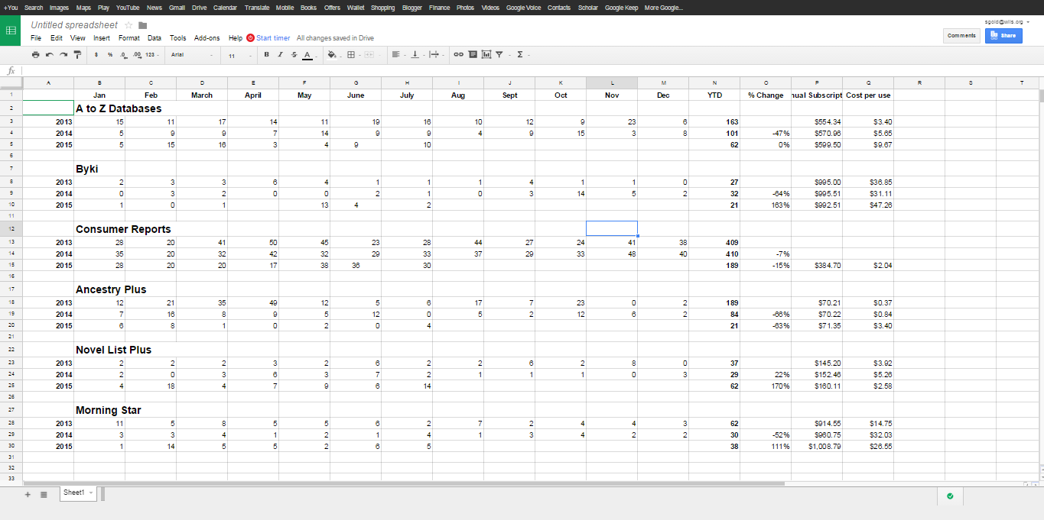
Usage comparison

Slide 23
Infographics are an excellent way to communicate to stakeholders.
Notes:
.

Slide 24
Make sure you explain the criteria you use in the evaluation

Slide 25
Understand outside factors

Slide 26
Compare Apples to Apples.

Slide 27
Question numbers
Notes:
Numbers are important, but they aren't everything. Full text downloads and cost-per-use are important metrics for determining the value of a resource, but they aren't the only things to consider. There may be resources that have deceivingly high costs-per-use, but are mission critical for a particular department or community segment. Be sure to take those factors into consideration when evaluating a product.

Slide 28
Include your staff in database evaluation

Slide 30
Example: Know More http://scls.typepad.com/ce/database_tips/

